Slide 1




GRADE 11 · ALGEBRA II · TOPIC 9
Lesson 9-2
Circles
Journey of 6 stations, 60 minutes
Conic Sections
Mr Malek Thiab
FAITH, RIGHTEOUSNESS AND WISDOM
Notes:
Speaker notes: Welcome to Lesson 9-2: Circles.
Timing: 60 minutes (Diagnose 6, Targeted Instruction 18, Practice 12, Production 12, Mastery Gate 6, Smart Production 6). For a 40-minute class scale every station by two thirds.
The journey map on the next slide shows the six stations; in slideshow mode the Morph transition zooms the station circles into the breadcrumb at the top of every later slide.

Slide 2


Today's journey
Six stations. Each one zooms in as we arrive.
Targeted Instruction
18 min
Production
12 min
Smart Production
6 min
2
4
6
1
3
5
Diagnose
6 min
Practice
12 min
Mastery Gate
6 min
FAITH, RIGHTEOUSNESS AND WISDOM
Notes:
Speaker notes: This is the whole map. Walk it left to right: Diagnose (what we already know), Targeted Instruction (The equation from the center and radius; Reading and writing circle equations; Completing the square for a circle; A line and a circle), Practice (Practice, Apply, Investigate), Production (Observation wheel on the Waterfront), Mastery Gate (three questions to pass), Smart Production (create, then Time to Check).
In slideshow mode the Morph transition animates these circles shrinking into the breadcrumb on later slides; without Morph the slides fade.
Ask the class which station they think will be hardest.

Slide 3
What we are learning
OBJECTIVES
VOCABULARY
Derive the equation of a circle given its center and radius.
Complete the square to find the center and radius of a circle.
Determine the relative positions of a circle and a line in the plane.
Solve a system of equations with one linear equation and one equation of a circle algebraically and verify the solution by graphing.
Center
Circle
Diameter
radius
STANDARDS
HSA.SSE.B.3 Choose and produce an equivalent form of an expression to reveal and explain properties of the quantity represented by the expression.
HSA.REI.C.7 Solve a simple system consisting of a linear equation and a quadratic equation in two variables algebraically and graphically.
HSG.GPE.A.1 Derive the equation of a circle of given center and radius using the Pythagorean Theorem; complete the square to find the center and radius of a circle given by an equation.
HSA.SSE.B.3 · HSA.REI.C.7 · HSG.GPE.A.1
FAITH, RIGHTEOUSNESS AND WISDOM
Mr Malek Thiab · 3
Notes:
Speaker notes: Read the objectives aloud one at a time and have students say which one they feel least sure about.
Vocabulary used today: Center, Circle, Diameter, radius.
Standards are listed on this slide.
The essential question and mathematical practices are not shown because they are not in the project documents; add them from the curriculum map if you want them displayed.

Slide 4
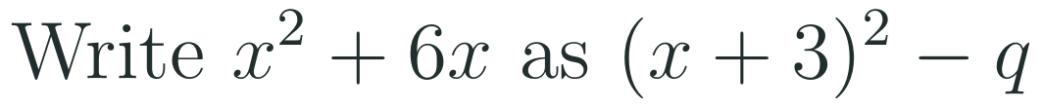

1
2
3
4
5
6
STATION 1 · DIAGNOSE · 6 MIN
Start here: three quick checks
1
2
3
Done when
All three answers are written without a calculator, and you can say which of the three skills a circle equation needs first.
HSA.SSE.B.3 · HSA.REI.C.7 · HSG.GPE.A.1
FAITH, RIGHTEOUSNESS AND WISDOM
Mr Malek Thiab · 4
Notes:
Speaker notes (Diagnose, 6 min, no calculator):
Answers. Q1: horizontal change 4, vertical change 3, distance √(16 + 9) = 5. Q2: half of 6 is 3 and 3² = 9, so x² + 6x = (x + 3)² − 9. Q3: (x + 4)(x − 2) = 0, so x = −4 or x = 2. Verbal misconceptions: Q1 students write 4 + 3 = 7 or forget the square root; Q2 students write (x + 3)² with no − 9, or (x + 6)²; Q3 students give x = 4 and x = −2 (sign flip). Adaptive routing: if >30% miss Q1, rehearse the distance formula and go to slide 5 slowly; if >30% miss Q2, spend two minutes on completing the square before slide 7; if >30% miss Q3, factor on the board before slide 8. If all three are secure, move quickly through slide 5 and start the Investigate route early.

Slide 5
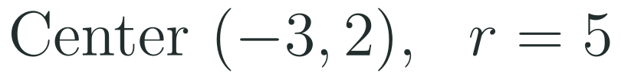

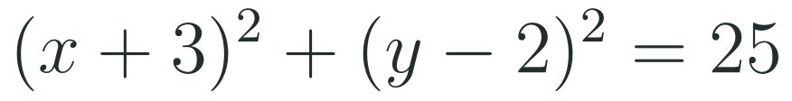
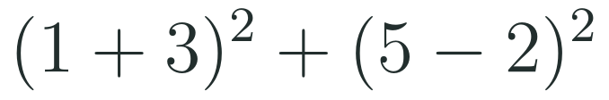

1
2
3
4
5
6
STATION 2 · TARGETED INSTRUCTION · 18 MIN
The equation from the center and radius
EXAMPLE A
EXAMPLE B
HSA.SSE.B.3 · HSA.REI.C.7 · HSG.GPE.A.1
FAITH, RIGHTEOUSNESS AND WISDOM
Mr Malek Thiab · 5
Notes:
Speaker notes (Targeted Instruction, block 1 of 4):
Worked solutions (HSG.GPE.A.1). A CIRCLE is every point at the same distance, the RADIUS r, from a fixed point, the CENTER (h, k). For a point (x, y) on the circle, the horizontal and vertical gaps from the center are x − h and y − k; the Pythagorean Theorem gives (x − h)² + (y − k)² = r². Example A: center (−3, 2), r = 5: x − (−3) = x + 3 and y − 2, so (x + 3)² + (y − 2)² = 25. Notice the sign flips inside the brackets and the number on the right is r², not r. Example B: substitute (1, 5): (1 + 3)² + (5 − 2)² = 16 + 9 = 25, equal to r², so the point is ON the circle; the gaps 4 and 3 make a 3-4-5 triangle. If the left side were less than 25 the point would be inside; if more, outside. Link to the pre-session: the distance of 5 in Diagnose Q1 is the same 3-4-5 idea. Verbal misconceptions: writing 5 on the right instead of 25; copying the signs of the center (x − 3); forgetting that r² uses the radius, not the diameter. Adaptive routing: if >30% write r instead of r², redo Example A and ask 'what is the distance squared?'; if >30% copy the signs, say 'flip the sign inside the bracket' aloud. Gate Q2 routes to this slide.

Slide 6


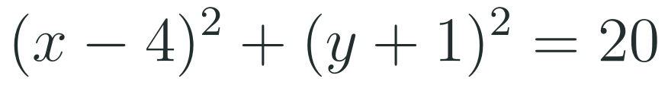
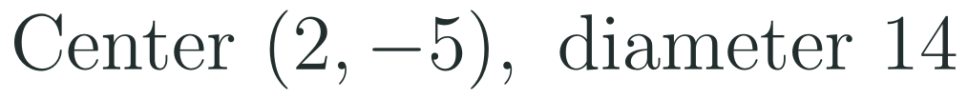
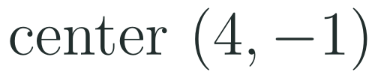
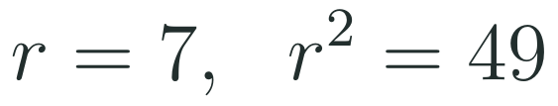
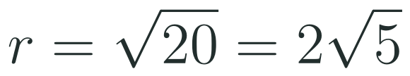
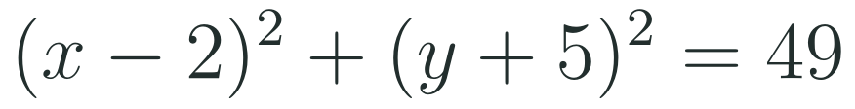
1
2
3
4
5
6
STATION 2 · TARGETED INSTRUCTION · 18 MIN
Reading and writing circle equations
EXAMPLE A
EXAMPLE B
HSA.SSE.B.3 · HSA.REI.C.7 · HSG.GPE.A.1
FAITH, RIGHTEOUSNESS AND WISDOM
Mr Malek Thiab · 6
Notes:
Speaker notes (Targeted Instruction, block 2 of 4):
Worked solutions. Example A: read the center with the signs flipped: x − 4 gives h = 4 and y + 1 = y − (−1) gives k = −1, so the center is (4, −1). The right-hand side is r² = 20, so r = √20 = 2√5 ≈ 4.47. Example B: the diameter 14 means r = 7, so r² = 49. Center (2, −5): (x − 2)² + (y + 5)² = 49. Check the point (9, −5): 49 + 0 = 49 ✓ (7 units to the right of the center). Verbal misconceptions: reading the center as (−4, 1); leaving the radius as 20; using the diameter 14 as r, giving 196. Adaptive routing: if >30% read the center wrongly, redo Example A with (x + 3)² + (y − 6)² = 9; if >30% use the diameter as r, ask 'half of the diameter?' before substituting. Gate Q1 routes to this slide.

Slide 7

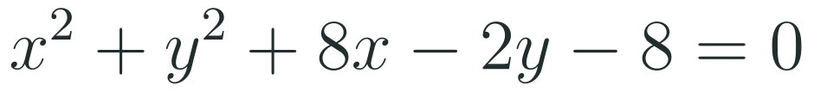
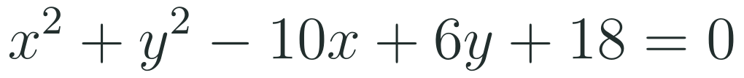
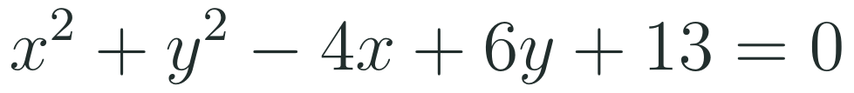
1
2
3
4
5
6
STATION 2 · TARGETED INSTRUCTION · 18 MIN
Completing the square for a circle
EXAMPLE A
EXAMPLE B
WHAT IF...?
What if the constant is 13 in x² + y² − 4x + 6y + 13 = 0? Predict the radius, then complete the square.
HSA.SSE.B.3 · HSA.REI.C.7 · HSG.GPE.A.1
FAITH, RIGHTEOUSNESS AND WISDOM
Mr Malek Thiab · 7
Notes:
Speaker notes (Targeted Instruction, block 3 of 4):
Worked solutions (HSA.SSE.B.3 and HSG.GPE.A.1). Method: move the constant to the right, group the x terms and the y terms, add the square of half the coefficient to BOTH sides for each letter, then factor. Example A: x² + 8x + y² − 2y = 8. Half of 8 is 4, 4² = 16; half of −2 is −1, (−1)² = 1. Add 16 and 1 to both sides: (x + 4)² + (y − 1)² = 8 + 16 + 1 = 25. Center (−4, 1), r = 5. Check: the point (1, 1) satisfies the original equation, 1 + 1 + 8 − 2 − 8 = 0, and (1 + 4)² + 0 = 25 ✓. Example B: x² − 10x + y² + 6y = −18. Add 25 and 9: (x − 5)² + (y + 3)² = −18 + 34 = 16. Center (5, −3), r = 4. What if (gold strip): x² − 4x + y² + 6y = −13; add 4 and 9: (x − 2)² + (y + 3)² = −13 + 13 = 0. The radius is 0: the graph is the single point (2, −3). If the right side were negative there would be no graph at all. Verbal misconceptions: adding 16 only on the left; reading r as 25 instead of 5; dropping the sign of the constant when moving it across. Adaptive routing: if >30% add on one side only, write the balance line 'what I add on the left I add on the right' and redo Example A; if >30% give r = 25, ask them to take the square root. Gate Q3 routes to this slide.

Slide 8
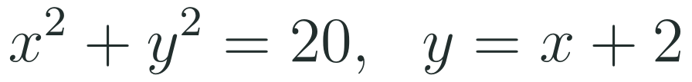
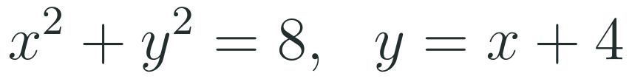
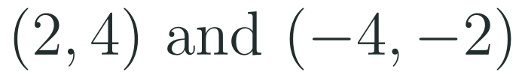

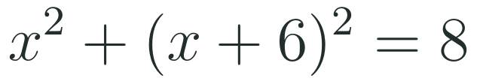
1
2
3
4
5
6
STATION 2 · TARGETED INSTRUCTION · 18 MIN
A line and a circle
EXAMPLE A
EXAMPLE B
WHAT IF...?
What if the line is y = x + 6 with the same circle x² + y² = 8? Predict how many points, then look at the discriminant.
HSA.SSE.B.3 · HSA.REI.C.7 · HSG.GPE.A.1
FAITH, RIGHTEOUSNESS AND WISDOM
Mr Malek Thiab · 8
Notes:
Speaker notes (Targeted Instruction, block 4 of 4):
Worked solutions (HSA.REI.C.7: a linear equation and a quadratic equation in two variables). Substitute the line into the circle to get one quadratic in x. Example A: x² + (x + 2)² = 20 gives 2x² + 4x + 4 = 20, so 2x² + 4x − 16 = 0 and x² + 2x − 8 = 0, (x + 4)(x − 2) = 0, x = −4 or x = 2. Then y = x + 2 gives y = −2 or y = 4: the points (−4, −2) and (2, 4). Verify on the circle: 16 + 4 = 20 ✓ and 4 + 16 = 20 ✓; verify on the graph: the line cuts the circle at two points (a SECANT). Example B: x² + (x + 4)² = 8 gives 2x² + 8x + 16 = 8, so 2x² + 8x + 8 = 0, x² + 4x + 4 = 0, (x + 2)² = 0, a repeated root x = −2, y = 2. Check: 4 + 4 = 8 ✓. One point of contact: the line is TANGENT to the circle. What if (gold strip): x² + (x + 6)² = 8 gives 2x² + 12x + 28 = 0, x² + 6x + 14 = 0; the discriminant is 36 − 56 = −20, which is negative: no real solutions, the line misses the circle. Verbal misconceptions: substituting into the wrong equation; squaring (x + 2)² as x² + 4; stopping after finding x and not finding y; thinking a single repeated root is 'no answer'. Adaptive routing: if >30% mis-square the bracket, expand (x + 2)² on the board; if >30% forget y, ask 'which equation gives y?'. Gate Q3 and Exit 2 route to this slide.

Slide 9
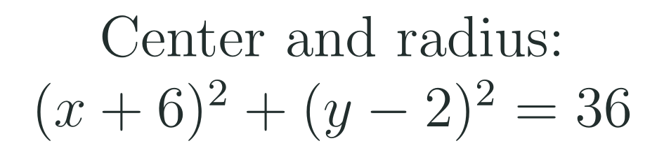
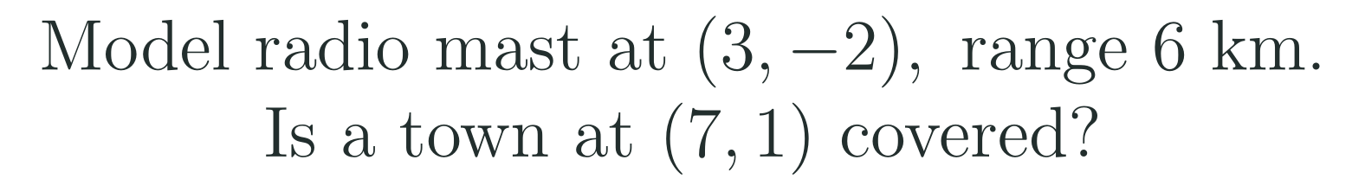
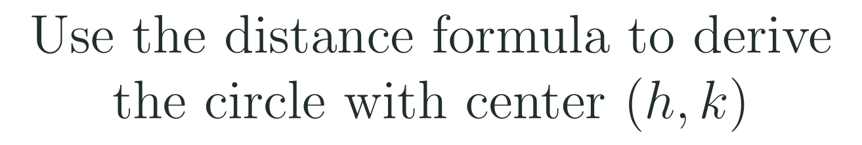
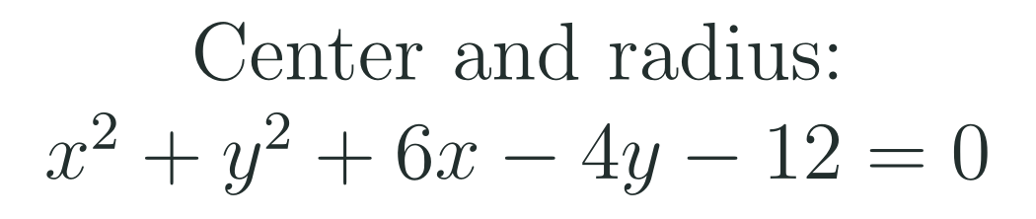
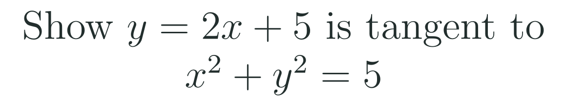
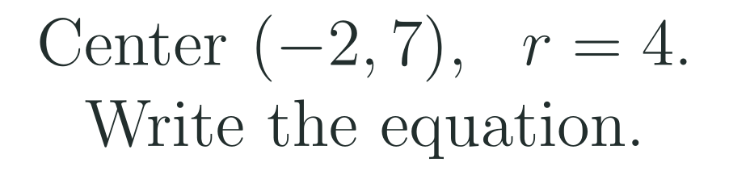
1
2
3
4
5
6
STATION 3 · PRACTICE · 12 MIN
Give it a go: Practice, Apply, Investigate
PRACTICE
APPLY
INVESTIGATE
Secure the method
Use it in context
Find out why
Done when: the center is read with the signs flipped, the right-hand side is treated as r², and the equation is checked with one point.
Done when: the center is placed first, the radius comes from r², and each answer says what it means in the context.
Done when: your argument starts from the distance formula or from one repeated solution, and every step stays balanced.
HSA.SSE.B.3 · HSA.REI.C.7 · HSG.GPE.A.1
FAITH, RIGHTEOUSNESS AND WISDOM
Mr Malek Thiab · 9
Notes:
Speaker notes (Practice, 12 min; tierless differentiation: students choose the starting column and may move across):
Answers. Practice 1: center (−6, 2), r = 6. Practice 2: (x + 2)² + (y − 7)² = 16. Apply 1 (a model radio mast near Jeddah, model values): distance² = (7 − 3)² + (1 + 2)² = 16 + 9 = 25 and 25 < 36, so the town is inside the covered range (5 km from the mast). Apply 2: (x + 3)² + (y − 2)² = 12 + 9 + 4 = 25; center (−3, 2), r = 5. Investigate 1: the distance from (x, y) to (h, k) is r: √((x − h)² + (y − k)²) = r; square both sides: (x − h)² + (y − k)² = r². Investigate 2: x² + (2x + 5)² = 5 gives 5x² + 20x + 20 = 0, x² + 4x + 4 = 0, (x + 2)² = 0, x = −2, y = 1: one point, so tangent; check 4 + 1 = 5 ✓. Verbal misconceptions: Practice 1 giving center (6, −2); Practice 2 giving 4 on the right; Apply 1 comparing 25 with 6 instead of 36; Apply 2 adding 9 and 4 on one side only; Investigate 2 stopping at a quadratic with no conclusion. Adaptive routing: if >30% miss Practice 1 or 2, route to slide 6; Apply 1, slide 5; Apply 2, slide 7; Investigate 1, slide 5; Investigate 2, slide 8. Students who finish Apply early move to Investigate.

Slide 10
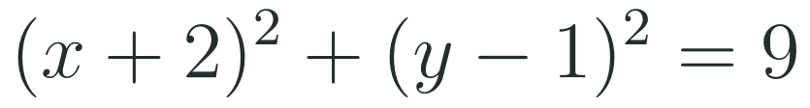
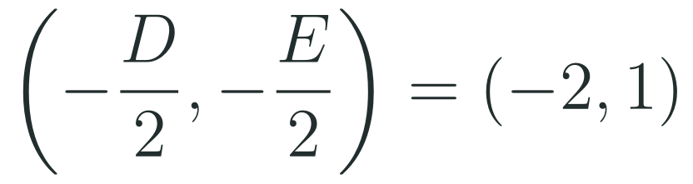
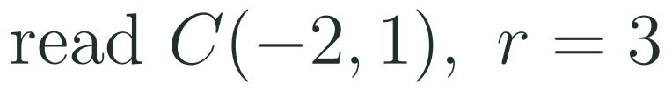
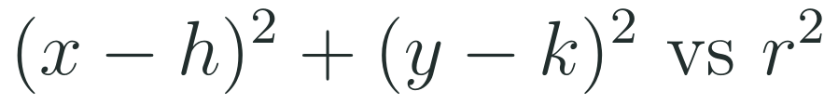

1
2
3
4
5
6
STATION 3 · PRACTICE · 12 MIN
Which route? Judge the claim
COMPLETE THE SQUARE
CENTER FORMULA
GRAPH OR TECHNOLOGY
JUDGE THE CLAIM
A line that meets a circle at exactly one point must be horizontal or vertical.
+ Exact: gives center and radius together.
+ Quick for the center.
+ Shows the whole circle.
TRUE
FALSE
SOMETIMES
− Adding to one side only spoils it.
− Radius still needs a formula.
− Exact values are hard to read.
CHECK THE ASSUMPTION
Did you test a line that is neither horizontal nor vertical?
SPOTLIGHT: STEAL THIS SHORTCUT
WHAT IF...?
To place a point, substitute it into the left side. Smaller than r² means inside, equal means on, larger means outside.
What if the radius doubles and the center stays the same? Predict what happens to r² and to the area, then test with r = 3.
HSA.SSE.B.3 · HSA.REI.C.7 · HSG.GPE.A.1
FAITH, RIGHTEOUSNESS AND WISDOM
Mr Malek Thiab · 10
Notes:
Speaker notes (inside Station 3, 3 minutes, after the Practice work):
Compare and judge (3 min). Worked solutions. The same circle x² + y² + 4x − 2y − 4 = 0 three ways. Complete the square: x² + 4x + y² − 2y = 4; add 4 and 1: (x + 2)² + (y − 1)² = 9, center (−2, 1), r = 3. Center formula: the center is (−D/2, −E/2) with D = 4 and E = −2, giving (−2, 1); the radius is √(h² + k² − F) = √(4 + 1 + 4) = 3, with F = −4. Graph: the picture shows the center and radius 3 if the scale is fine. Claim: FALSE. The line y = x + 4 is tangent to x² + y² = 8 (slide 8 Example B) and is neither horizontal nor vertical. Spotlight: for (3, 3) and x² + y² = 8 gives 18 > 8, so outside. What if (gold box): r becomes 2r, so r² becomes 4r² (four times), and the area πr² becomes 4πr²; for r = 3, r² = 9 becomes 36 and the radius 6. Verbal misconceptions: 'tangent lines are horizontal or vertical'; 'doubling the radius doubles r²'; 'the graph gives exact values'. Adaptive routing: if >30% mark the claim TRUE, have them test y = x + 4 against x² + y² = 8; if teams finish early, ask which route they would use for x² + y² − 6x + 4y − 3 = 0 and why.

Slide 11

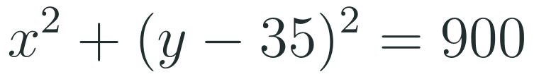
1
2
3
4
5
6
STATION 4 · PRODUCTION · 12 MIN
Production: Observation wheel on the Waterfront
THE MODEL
DONE WHEN
A model observation wheel on the Jeddah Waterfront (model values only, not real data) has its center 35 m above the ground and a radius of 30 m. Use coordinates with the ground as y = 0 and the center at (0, 35).
The equation x² + (y − 35)² = 900 is written, with the highest height 65 m and the lowest 5 m.
The points are classified using the left-hand side: 900 on, 125 inside, 1525 outside.
The platform y = 11 gives x = ±18 and a chord of 36 m.
The line y = 5 gives x² = 0, one point, and is explained as tangent at the lowest cabin.
Write the equation of the wheel. Find the highest and lowest heights of a cabin above the ground.
Classify the points (18, 59), (10, 40) and (30, 60) as on, inside or outside the wheel.
A boarding platform lies along y = 11. Find where it meets the wheel and the length of the chord. What happens along y = 5?
Hint for solving: substitute the line into the circle and solve for x.
WHAT IF...?
What if the radius is 25 m with the same center? Predict whether the line y = 5 still touches the wheel, then test it.
HSA.SSE.B.3 · HSA.REI.C.7 · HSG.GPE.A.1
FAITH, RIGHTEOUSNESS AND WISDOM
Mr Malek Thiab · 11
Notes:
Speaker notes (Production, 12 min):
Model values only, not real data. Task 1: center (0, 35), r = 30, so x² + (y − 35)² = 900. The highest point is 35 + 30 = 65 m and the lowest is 35 − 30 = 5 m. Task 2: (18, 59): 324 + 576 = 900, ON. (10, 40): 100 + 25 = 125 < 900, INSIDE. (30, 60): 900 + 625 = 1525 > 900, OUTSIDE. Task 3: y = 11: x² + (11 − 35)² = x² + 576 = 900, so x² = 324 and x = ±18. The points are (−18, 11) and (18, 11), and the chord is 36 m long. For y = 5: x² + 900 = 900, so x² = 0, x = 0: one point (0, 5), a tangent at the lowest cabin, so a platform at y = 5 would just touch the wheel. What if (gold box): r = 25, center (0, 35): x² + (y − 35)² = 625; at y = 5: x² + 900 = 625 gives x² = −275, no solution: the platform at 5 m misses the wheel (its lowest point is now 10 m). Verbal misconceptions: using 30 instead of 900; using (y + 35) for a center at 35; thinking x = ±18 is one point; forgetting units. Adaptive routing: if >30% cannot start Task 1, return to slide 5 Example A; if >30% miss Task 2, slide 5 Example B; if >30% miss Task 3, slide 8. Early finishers: the platform height at which the chord is 48 m (x = ±24, (y − 35)² = 324, y = 17).

Slide 12
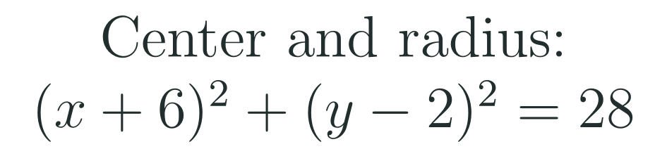
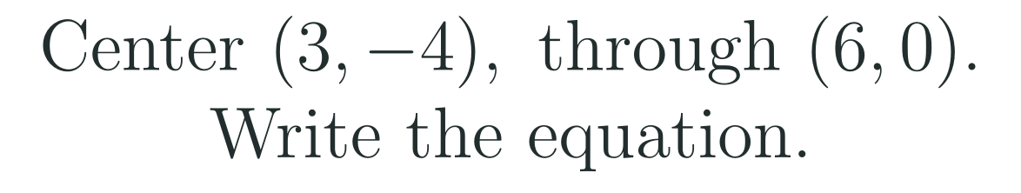
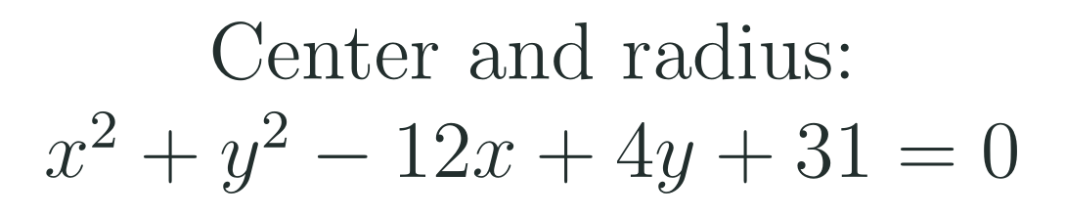
1
2
3
4
5
6
STATION 5 · MASTERY GATE · 6 MIN
Mastery Gate: three questions to pass
1
2
3
Pass mark
3 of 3 correct unlocks Station 6. Fewer than that: return to the slide for the question you missed, redo it, then re-take the gate.
HSA.SSE.B.3 · HSA.REI.C.7 · HSG.GPE.A.1
FAITH, RIGHTEOUSNESS AND WISDOM
Mr Malek Thiab · 12
Notes:
Speaker notes (Mastery Gate, 6 min, no calculator):
Answers. Q1: center (−6, 2), r = √28 = 2√7. Q2: r² = (6 − 3)² + (0 + 4)² = 9 + 16 = 25, so (x − 3)² + (y + 4)² = 25. Q3: x² − 12x + y² + 4y = −31; add 36 and 4: (x − 6)² + (y + 2)² = −31 + 40 = 9; center (6, −2), r = 3. Verbal misconceptions: Q1 giving center (6, −2) or r = 28; Q2 using 5 instead of 25 or the distance formula without squaring; Q3 adding 36 and 4 on the left only, or taking r = 9. Adaptive routing: Q1 missed, route to slide 6; Q2 missed, slide 5; Q3 missed, slide 7. If a student misses two or more, they join the teacher group for the Smart Production create step; students who get all three correct start the create step immediately.

Slide 13
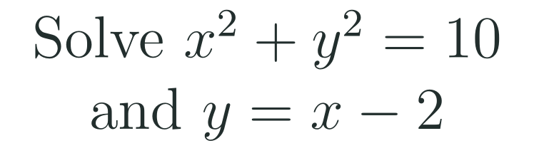
1
2
3
4
5
6
STATION 6 · SMART PRODUCTION · 6 MIN
Smart Production: make one, then check it
CREATE
TIME TO CHECK
Choose a center (h, k) and a radius r. Write the equation, then expand it to the form x² + y² + Dx + Ey + F = 0.
Swap with a partner: complete the square on their expanded equation and check you recover the center and radius.
Add a line of your choice and find how many points it shares with the circle. Then add a What if...? question (change the radius) and test your prediction.
Exit ticket: write your answer on a sticky note and place it on the door.
Done when: your equation and expanded form agree, your partner recovers the same center and radius, and your What if...? question has a prediction and a test.
Next lesson: 9-3 Ellipses.
HSA.SSE.B.3 · HSA.REI.C.7 · HSG.GPE.A.1
FAITH, RIGHTEOUSNESS AND WISDOM
Mr Malek Thiab · 13
Notes:
Speaker notes (Smart Production, 6 min):
Exit ticket solutions. Exit 1: add 9 and 4: (x + 3)² + (y − 2)² = 12 + 9 + 4 = 25; center (−3, 2), r = 5. Exit 2: x² + (x − 2)² = 10 gives 2x² − 4x + 4 = 10, 2x² − 4x − 6 = 0, x² − 2x − 3 = 0, (x − 3)(x + 1) = 0: x = 3 or −1, giving (3, 1) and (−1, −3); check 9 + 1 = 10 and 1 + 9 = 10 ✓. Create step example: center (1, −2), r = 3: (x − 1)² + (y + 2)² = 9, expanded x² + y² − 2x + 4y − 4 = 0; the line y = 1 gives (x − 1)² + 9 = 9, x = 1: tangent at (1, 1). What if: r = 2 gives (x − 1)² + (y + 2)² = 4 and y = 1 then gives (x − 1)² = −5, no points. Verbal misconceptions: Exit 1 giving center (3, −2) or r = 25; Exit 2 expanding (x − 2)² as x² − 4. Adaptive routing: if >30% miss Exit 1, retrieve slide 7 Example A next lesson; if >30% miss Exit 2, retrieve slide 8 Example A.

Slide 14
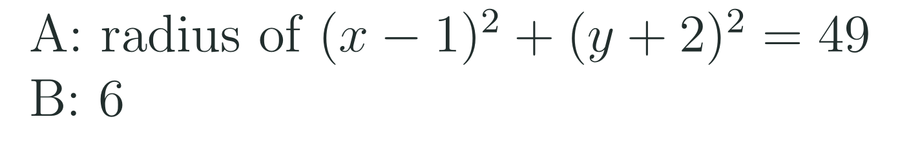
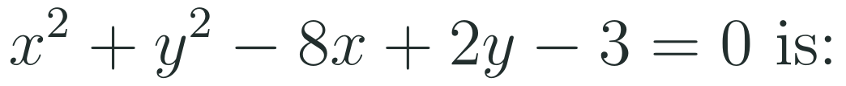
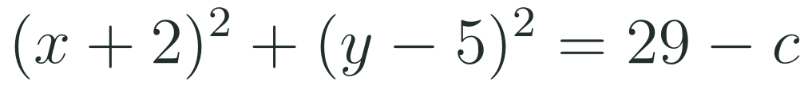

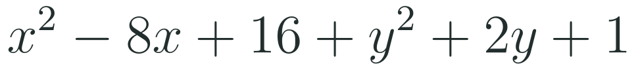




Exam connections
SAT
GAT
SAAT
STEPS
STEPS
STEPS
1
1
1
2
2
2
3
3
3
HSA.SSE.B.3 · HSA.REI.C.7 · HSG.GPE.A.1
FAITH, RIGHTEOUSNESS AND WISDOM
Mr Malek Thiab · 14
Notes:
Speaker notes: each exam item is worked in numbered steps.
SAT (Advanced Math, circles): complete the square: (x² + 4x + 4) + (y² − 10y + 25) = −c + 29, so (x + 2)² + (y − 5)² = 29 − c. The radius is 6, so r² = 36 and 29 − c = 36, c = −7. Traps: setting 29 − c = 6 (using r instead of r²), giving c = 7, or 23. A student-produced-response grid answer is −7. GAT/Qudurat quantitative comparison (A is greater / B is greater / equal / cannot be determined): r² = 49, r = 7 > 6, so A is greater. Trap: taking 49 as the radius. SAAT/Tahsili (four options, for example A (−4, 1), B (4, −1), C (8, −2), D (4, 1)): D = −8, E = 2, so the center is (−D/2, −E/2) = (4, −1): B. Trap: (−4, 1) from copying the signs of the equation. Adaptive routing: if >30% miss the SAT item, return to slide 7 Example A; the GAT item, slide 6 Example A; the SAAT item, slide 7 Example A.

Slide 15
Journey complete
Targeted Instruction
Production
Smart Production
✓
✓
✓
✓
✓
✓
Diagnose
Practice
Mastery Gate
A circle is every point at a fixed distance r from its center; its equation comes from the Pythagorean Theorem, completing the square reveals the center and radius, and substituting a line into it shows how line and circle meet.
FAITH, RIGHTEOUSNESS AND WISDOM
Notes:
Speaker notes: Every station is checked off. Recap in one sentence: A circle is every point at a fixed distance r from its center; its equation comes from the Pythagorean Theorem, completing the square reveals the center and radius, and substituting a line into it shows how line and circle meet. Collect the Time to Check responses. Next lesson: 9-3 Ellipses.

